Slide 2
Notes:
Teacher notes
In ‘Slide Show’ mode, click the name of a section to jump straight to that slide.

Slide 3
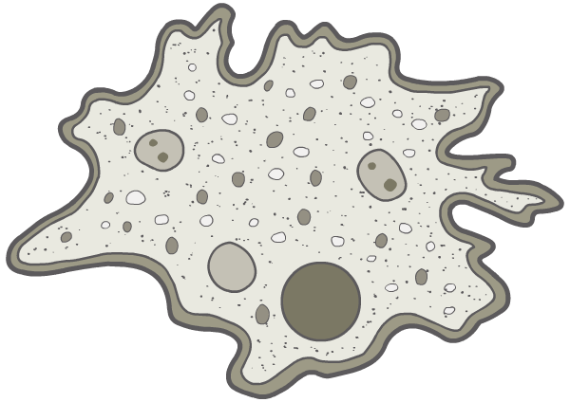

Why need a transport system?
Single-celled organisms, such as bacteria and amoeba (below), can obtain nutrients and excrete waste simply by diffusion.
nutrients
waste products
Multi-cellular organisms, such as insects, fish and mammals, require a more specialized transport system. Why is this?

Slide 4

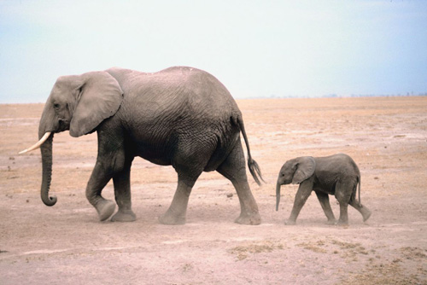
Surface area to volume ratio
In larger organisms, diffusion of substances would occur far too slowly to enable them to survive: the rate of diffusion increases with the square of the distance it has to travel.
This is not just because of its size, however: more important is an organism’s surface area to volume ratio.
Single-celled organisms have a very large surface area to volume ratio, because the diffusion path is so short.
Notes:
Photo credit: Jupiterimages Corporation
Teacher notes
Flatworms have no specialized transport system but rely on diffusion to distribute oxygen, nutrients and waste products. Students could be asked to state why they think flatworms are able to survive without a transport system.

Slide 5
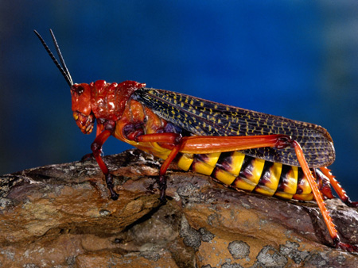
Components of circulatory systems
Multi-cellular animals overcome the limitations of diffusion by having a specialized circulatory system. This comprises:
a heart
a fluid in which substances are transported
vessels through which the fluid can flow.
The two types of circulatory system are open (e.g. molluscs, arthropods) and closed (e.g. vertebrates, a few invertebrates).

Slide 6
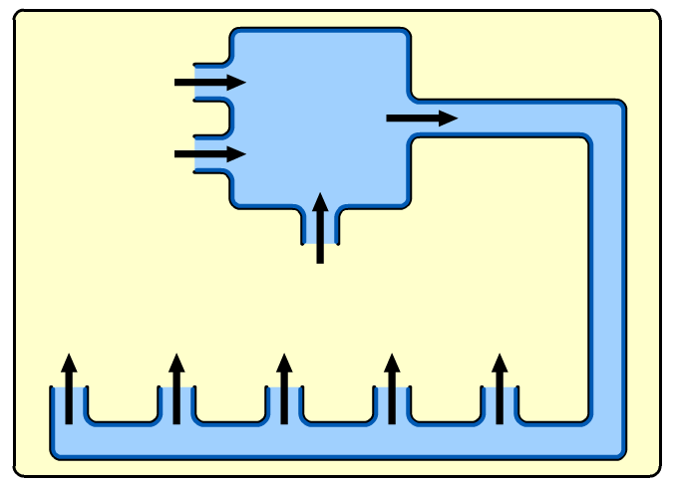
Open circulatory systems
An open circulatory system consists of a heart that pumps a fluid called haemolymph through short vessels and into a large cavity called the haemocoel.血腔
In the haemocoel, the haemolymph directly bathes organs and tissues, enabling the diffusion of substances.
heart
haemocoel
Haemolymph moves around the haemocoel due to the movement of the organism.

Slide 7
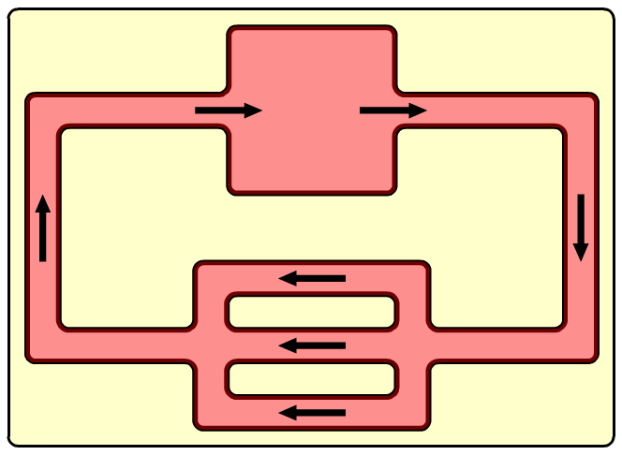
Closed circulatory systems
In a closed circulatory system, blood is fully enclosed within blood vessels at all times.
From the heart, blood is pumped through a series of progressively smaller vessels. In the smallest vessels, capillaries, substances diffuse in and out of the blood and into cells.
heart
capillaries
Blood then returns to the heart via a series of progressively larger vessels.

Slide 8

Closed circulatory systems

Slide 9
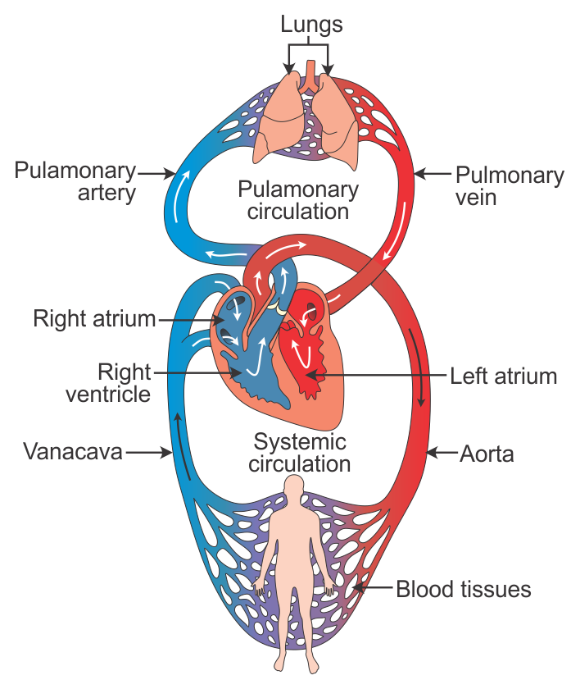
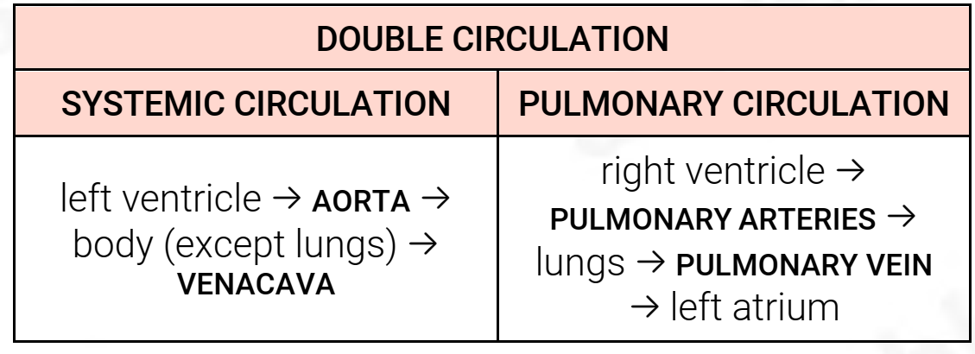
ventricle

Slide 10
The mammalian circulatory system

Slide 11
Circulation: true or false?

Slide 12
Notes:
Teacher notes
In ‘Slide Show’ mode, click the name of a section to jump straight to that slide.

Slide 13
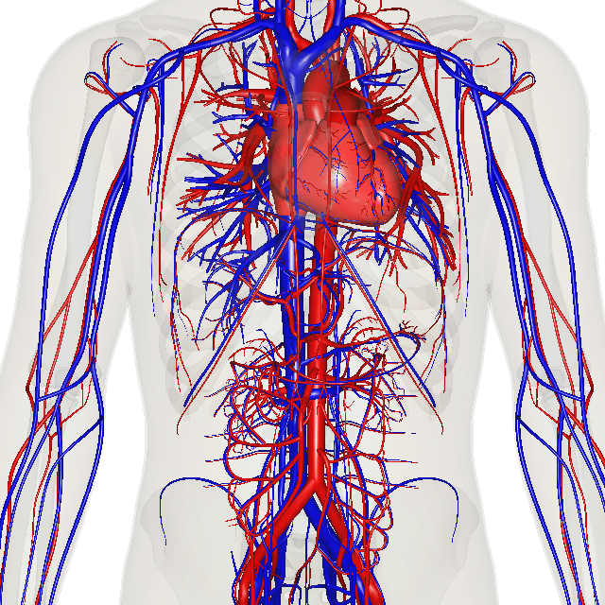
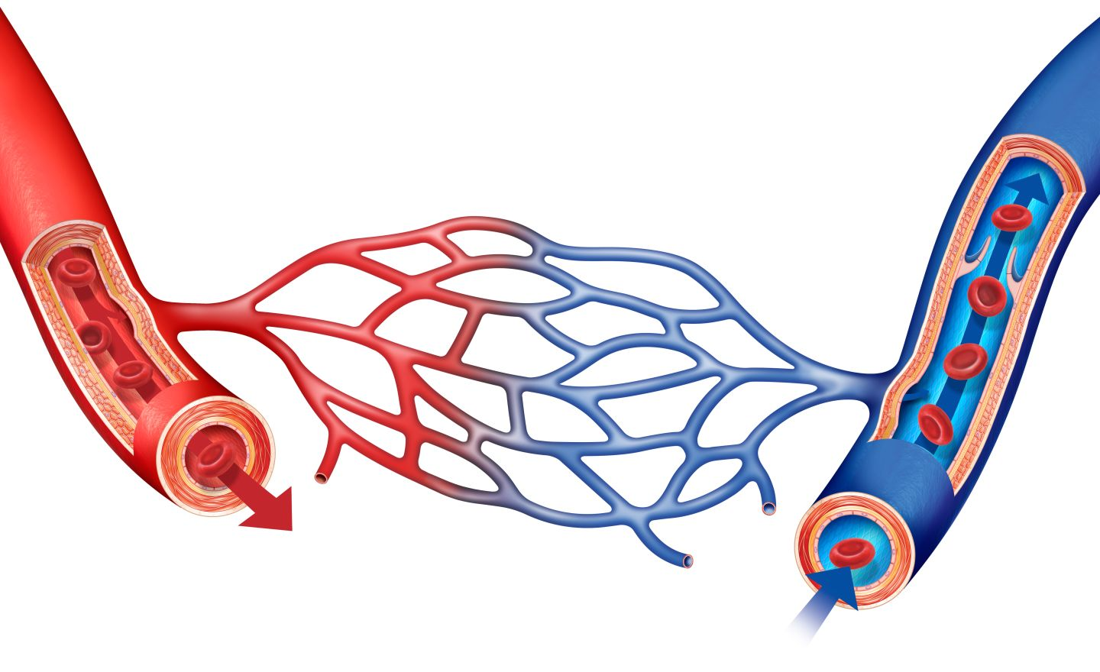
2h – Transport – Humans
Blood vessels
Blood flows to almost every single cell in the body.
It does this through a complex network of blood vessels.
There are three types: Arteries动脉,arteriole小动脉、 veins静脉、venule小静脉 and capillaries毛细血管.
By BodyParts3D/Anatomography - Anatomography, CC BY-SA 2.1 jp, https://commons.wikimedia.org/w/index.php?curid=35786381
If you took them all out and put them in a line they would stretch for almost 100,000 miles

Slide 14
Guide to blood vessels

Slide 15
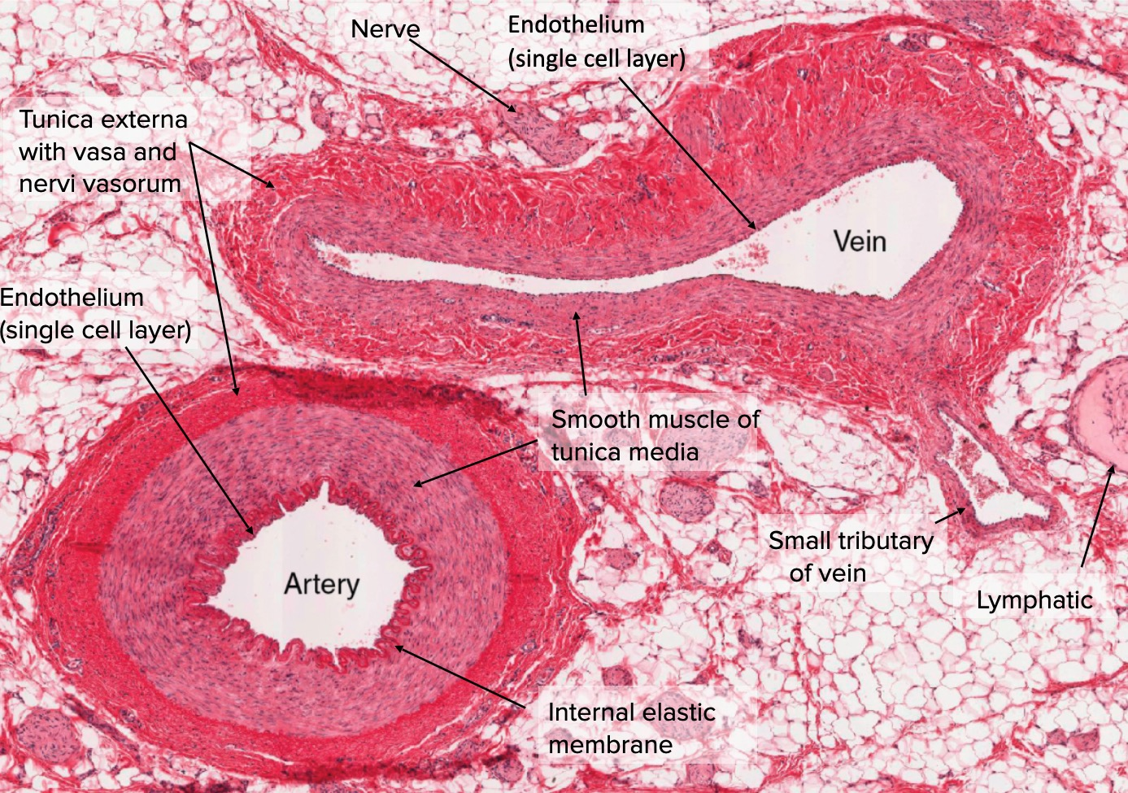
2h – Transport – Humans
Arteries and Veins
Wall
Lumen
Vein
Artery
Thin wall with little smooth muscle and elastic tissue，collagen fiber
Large lumen
Carrying blood back to the heart.
Contains valves.
deoxygenated blood
Thick wall with lots of smooth muscle fibres and elastic tissue.collagen fiber
Small lumen
Carrying blood away from heart.
oxygenated blood

Slide 16
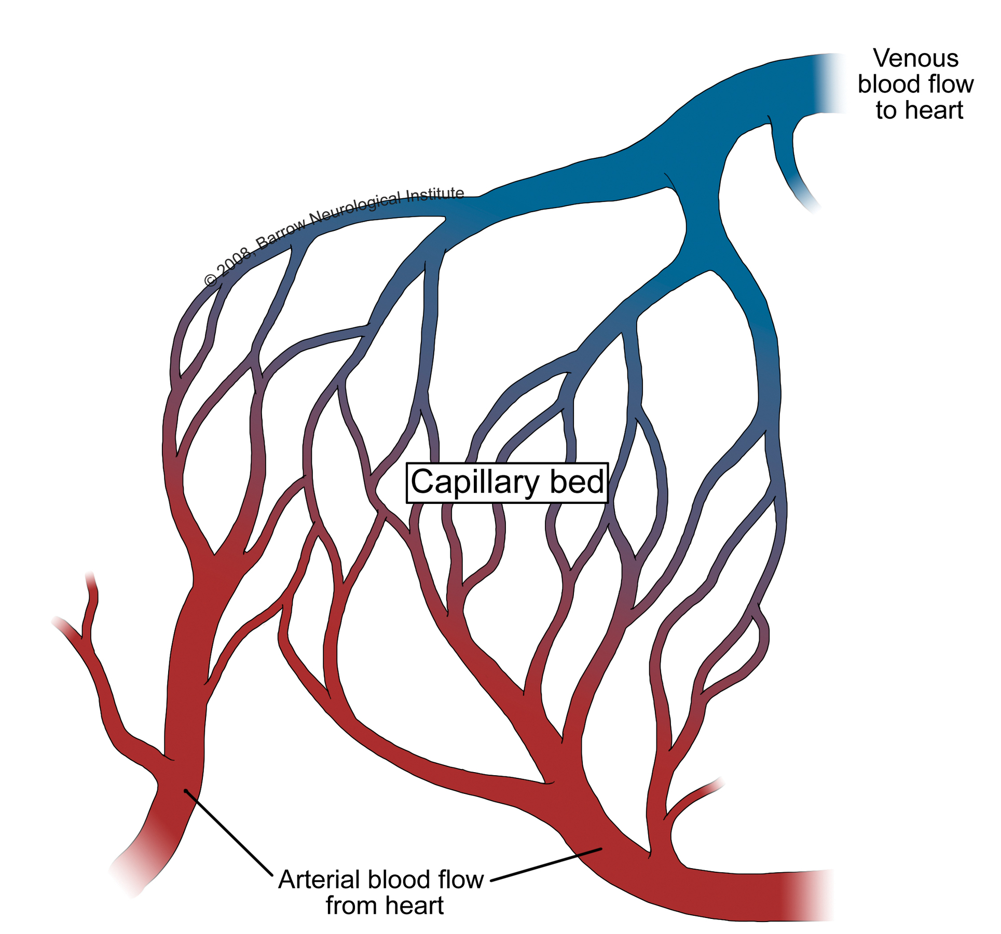
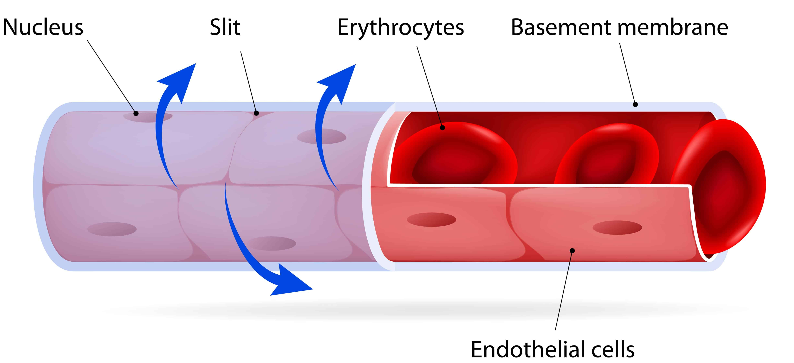
Capillaries
The tiniest blood vessels (7μm).
The capillary wall is one cell thick
The wall is permeable and allow substances to exchange
lumen is one cell wide
gaps are present between individual cells which allow some components of blood to seep through into spaces between cells (tissue fluid)

Slide 17
Identifying blood vessels

Slide 18
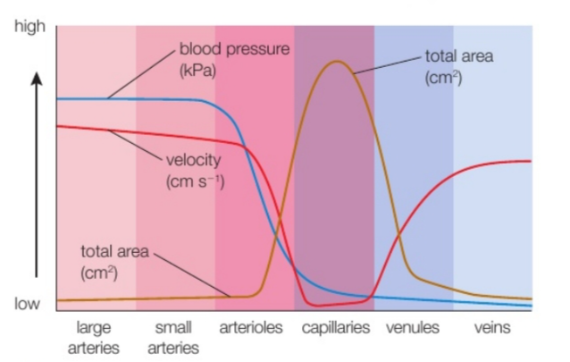
p39
blood pressure：arteries>capillaries>veins
velocity:arteries>veins>capillaries
area:capillaries

Slide 19
Blood flow in veins

Slide 20
Maintaining high blood pressure
Blood pressure is the main force that drives blood from the heart around the body.
During systole (heart contraction), blood is pumped through the aorta and other arteries at high pressure. The elastic fibres of arteries enable them to expand and allow blood through.
During diastole (heart relaxation), the blood pressure in the arteries drops. The elastic recoil of the artery walls help force the blood on.
As blood moves through smaller arterioles into capillaries, and then into venules and veins, its velocity and pressure drop continuously.
Notes:
Teacher notes
Students could be asked to draw a line graph of how they think blood pressure varies as it moves through the aorta, arteries, arterioles, capillaries, venules and veins.
See the ‘The Heart’ presentation for more information about systole and diastole.

Slide 21
Arteries, capillaries and veins

Slide 22
Notes:
Teacher notes
In ‘Slide Show’ mode, click the name of a section to jump straight to that slide.

Slide 23
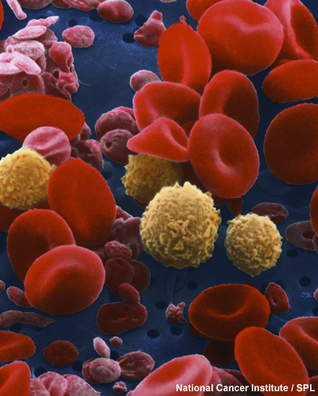
What is blood?
Blood is a specialized transport medium that is also considered a special type of connective tissue. An average adult has 4–6 litres of blood.
Blood has a range of functions such as:
transport
defence
maintaining pH of body fluids.

Slide 24
The composition of blood

Slide 25
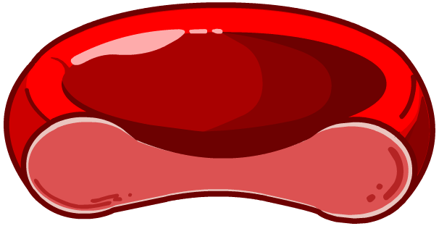
Features of erythrocytes
What are the specialized features of an erythrocyte?
flattened, biconcave disc shape: ensures large surface area to volume ratio for efficient gas exchange
large amount of haemoglobin: for transporting oxygen
produced
in the
bone marrow
no nucleus or organelles: maximises space for haemoglobin, so more oxygen can be transported
diameter (6–8 µm) similar with capillary diameter: quickly exchange oxygen with the fluid
outside the cell.

Slide 26
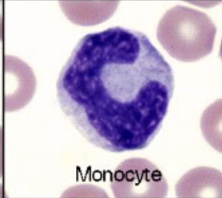
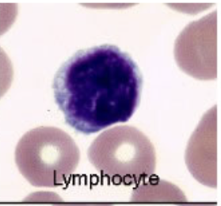
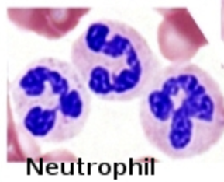
white blood cell/leukocyte
white blood cells all have a nucleus，immunity
white blood cells are either spherical or irregular in shape most white blood cells are larger than red blood cells
Phagocytes吞噬细胞: phagocytosis.
neutrophil中性粒细胞,lobed nucleus分叶的核 and granular颗粒状 cytoplasm.
Monocytes单核细胞 are cells that can develop into a different type of phagocyte called a macrophage巨噬细胞，irregular nucleus
lymphocyte：smallest cell with large nucleus

Slide 27
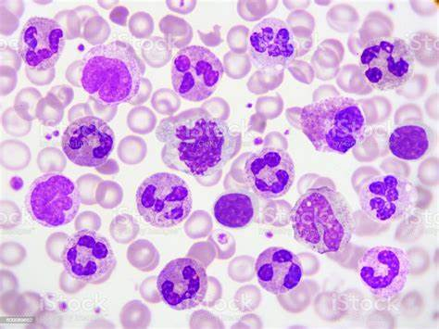

Slide 28
Blood clotting

Slide 29
Substances in blood clotting

Slide 30
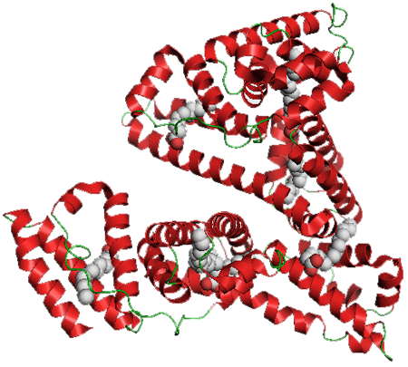
Plasma proteins and blood pressure
About 8% of blood plasma consists of plasma proteins, of which about half may be albumins.
These are a group of small proteins involved in the transport of other substances (e.g. fatty acids, hormones) and which help regulate the osmotic pressure of blood.
The balance between the hydrostatic pressure of blood (‘blood pressure’) and the osmotic pressure渗透压 of blood is important in the formation of tissue fluid.

Slide 31
Composition of body fluids

Slide 32
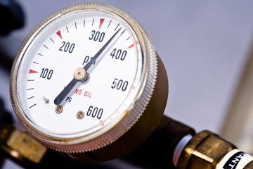
How is oxygen concentration measured?
Oxygen binds to haemoglobin when oxygen is at a high concentration, and dissociates from haemoglobin when oxygen is at a low concentration.
The concentration of a gas in a mixture of gases can be quantified in terms of its partial pressure. This is the amount of pressure exerted by the gas relative to the total pressure exerted by all the gases in the mixture.--O2：21%
Partial pressure is measured in kilopascals (kPa) and is written as P(O₂), P(CO₂), etc.
Notes:
Photo credit: Jupiterimages Corporation
Teacher notes
When a gas is dissolved in a liquid, as is the case with gas transport in blood, the partial pressure is slightly more complex. In this case, the liquid is treated as if it were in equilibrium with a gas phase, and the partial pressures are those that would be exerted by the gases in that phase.

Slide 33
The haemoglobin dissociation curve氧离曲线
Hb + 4O₂ → HbO₈
haemoglobin oxyhaemoglobin
dissociation curve: a graph showing the percentage saturation of a haemoglobin with oxygen, plotted against the partial pressure of oxygen
partial pressure分压: a measure of the concentration of a gas

Slide 34
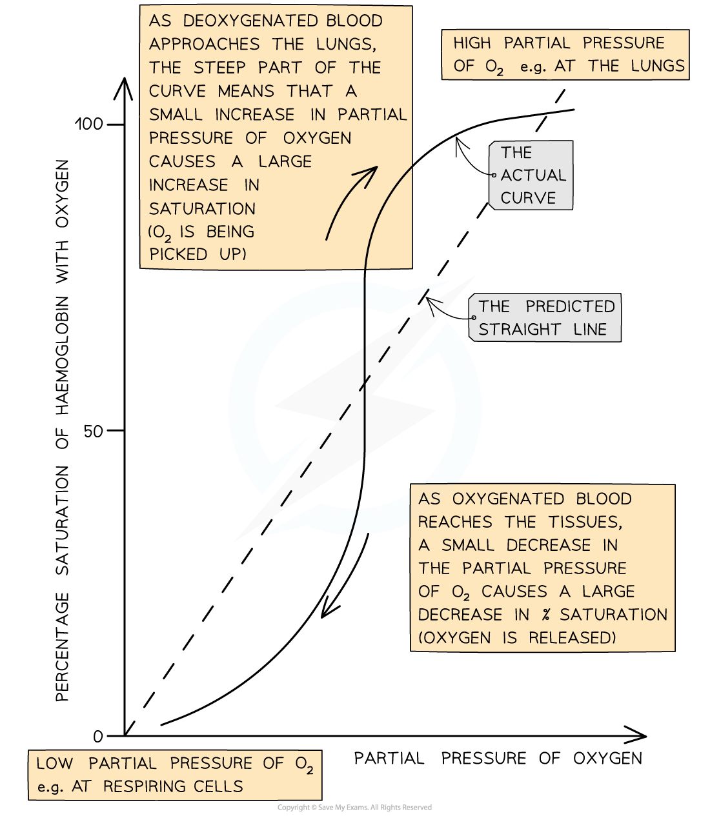
1.At low pO2, oxygen binds slowly to haemoglobin; this means that haemoglobin cannot pick up oxygen，Haemoglobin has a low affinity for oxygen at low pO2, so saturation percentage is low
2.At medium pO2, oxygen binds more easily to haemoglobin and saturation increases quickly; a small increase in pO2 causes a large increase in haemoglobin saturation
3.At high pO2, oxygen binds easily to haemoglobin; become saturated as blood passes through the lungs
Haemoglobin has a high affinity for oxygen at high pO2, so saturation percentage is high

Slide 35
The oxygen dissociation curve

Slide 36
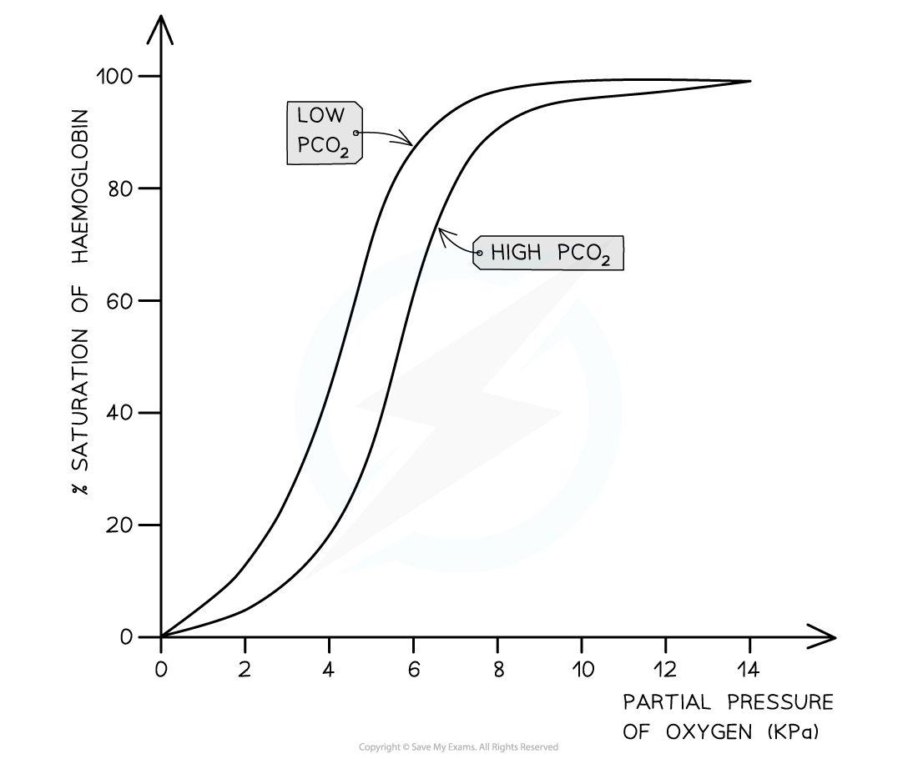
Bohr shift波尔效应
The presence of a high partial pressure of carbon dioxide causes haemoglobin to release oxygen
shift in the curve of oxyhaemoglobin due to concentration of CO₂ at a given partial pressure of O2 is Bohr effect

Slide 37
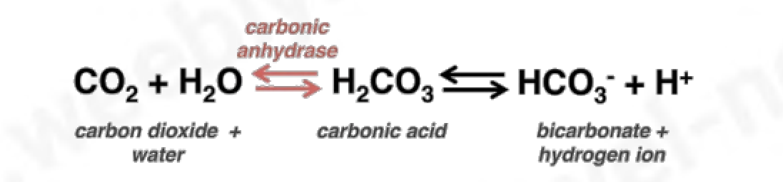
Bohr shift波尔效应--207
Hb + H⁺ —— HHb + O₂
CO2 is catalysed by carbonic anhydrase enzyme when it reacts with water to form carbonic acid
when the carbonic acid dissociates; haemoglobin combines with H+ ions forming haemoglobunic acid (HHb) and releases the O2 it’s carrying
maintains blood pH as if the H ions were left in solution,otherwise the blood turns acidic

Slide 38
Factors affecting oxygen dissociation

Slide 39
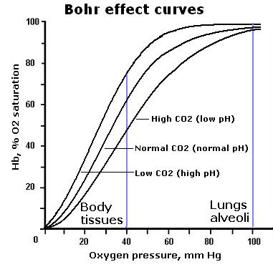
presence of high partial pressures of CO2 causes haemoglobin to release O2
• high concentration of O2 is found in respiring tissues
which need O2
• high concentration of CO2 causes Hb to release O2,
curve lies below and to the right

Slide 40
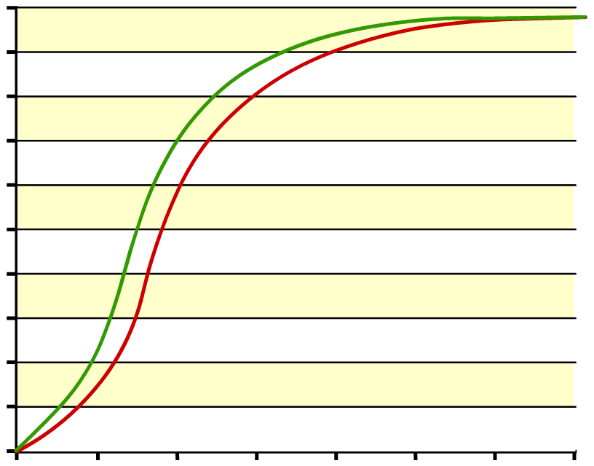
Foetal haemoglobin
The red blood cells in the foetal bloodstream contain a special form of haemoglobin known as foetal haemoglobin.
Foetal haemoglobin has a higher affinity for oxygen than adult haemoglobin.
foetal haemoglobin
100
90
80
70
adult haemoglobin
60
This helps maximize oxygen uptake from the mother’s blood stream, which has already lost some of its oxygen by the time it reaches the placenta.
oxyhaemoglobin (% saturation)
50
40
30
20
10
0
0
2
4
6
8
10
12
14
oxygen partial pressure (kPa)

Slide 41
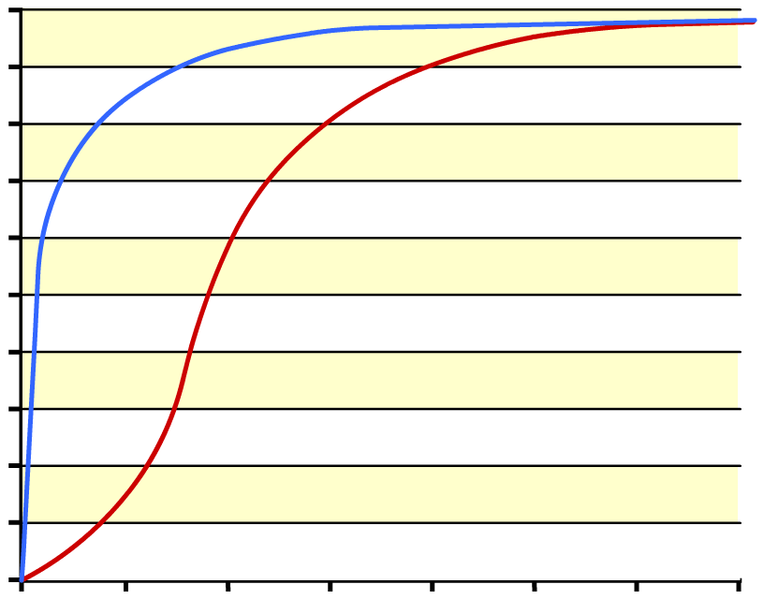
What is myoglobin?
Myoglobin is a molecule with a similar structure to haemoglobin, but with only one haem group.
Myoglobin has a very high affinity for oxygen, even at very low partial pressures.
myoglobin
100
90
80
70
haemoglobin
60
oxyhaemoglobin (% saturation)
This means oxymyoglobin will only dissociate when oxygen levels are low. It is found in muscle cells, where it acts as an oxygen reserve.
50
40
30
20
10
0
0
2
4
6
8
10
12
14
oxygen partial pressure (kPa)

Slide 42
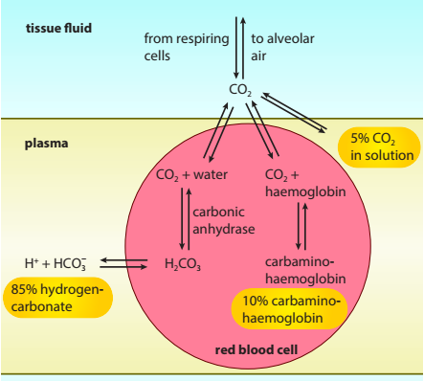
CO2 transport
As hydrogencarbonate ions in the blood plasma：Most of the hydrogencarbonate ions then diffuse out of the red blood cell into the blood plasma, where they are carried in solution. About 85%
As dissolved carbon dioxide molecules in the blood plasma：5%
As carbaminohaemoglobin
氨甲酰血红蛋白：they combine directly with the terminal amine groups (–NH2) of some of the haemoglobin molecules.
The compound formed is
called carbaminohaemoglobin. About 10%

Slide 43
Notes:
Teacher notes
In ‘Slide Show’ mode, click the name of a section to jump straight to that slide.

Slide 44
Glossary

Slide 45
What’s the keyword?

Slide 46
Multiple-choice quiz

